Slide 1
Rotational InertiA
GAME 256

Slide 2
Rotational Inertia
Mass measures resistance to a change in linear velocity.
Rotational Inertia measures resistance to a change in angular velocity.

Slide 3

Review
$I$ = rotational inertia
We used rotational inertia $I$ in 2D last year.
It was represented as a vector.

Slide 4

Inertia Tensor
1D: $I$ is a scalar.
2D: $I$ is a vector.
3D: $I$ is a 3x3 matrix

Slide 5

Deriving Inertia
To derive inertia we need to go back. to the future
Angular Momentum: $L=Iω$
Formally: $L=r×p$
Where: $r$ is the distance to the axis of rotation
And: $p=mv$ is the linear momentum

Slide 6

Deriving Inertia
$L=\sum{r×vdm}$
Now use: $v=ω×r$
To find: $L=∫r×\left(ω×r\right)dm$
Consider: $r=\left[\begin{matrix}x & y & z\end{matrix}\right]$
And: $ω=\left[\begin{matrix}ω_{x} & ω_{y} & ω_{z}\end{matrix}\right]$

Slide 7

Deriving Inertia
$L=∫\left[\begin{matrix}\left[\begin{matrix}\left(y^{2}+z^{2}\right)ω_{x} & −xyω_{y} & −xzω_{z}\end{matrix}\right]i+ \\ \left[\begin{matrix}−yxω_{x} & \left(z^{2}+x^{2}\right)ω_{y} & −yzω_{z}\end{matrix}\right]j+ \\ \left[\begin{matrix}{−zxω}_{x} & −zyω_{y} & \left(x^{2}+y^{2}\right)ω_{z}\end{matrix}\right]k\end{matrix}\right]dm$
Simplify with:
$I_{xx}=∫\left(y^{2}+z^{2}\right)dm$
$I_{yy}=∫\left(z^{2}+x^{2}\right)dm$
$I_{zz}=∫\left(x^{2}+y^{2}\right)dm$
$I_{xy}=∫\left(xy\right)dm$
$I_{xz}=∫\left(xz\right)dm$
$I_{yz}=∫\left(yz\right)dm$

Slide 8

Deriving Inertia
$L=∫\left[\begin{matrix}\left[\begin{matrix}I_{xx}ω_{x} & −I_{xy}ω_{y} & −I_{xz}ω_{z}\end{matrix}\right]i+ \\ \left[\begin{matrix}−I_{yx}ω_{x} & I_{yy}ω_{y} & −I_{yz}ω_{z}\end{matrix}\right]j+ \\ \left[\begin{matrix}{−I_{zx}ω}_{x} & −I_{zy}ω_{y} & I_{zz}ω_{z}\end{matrix}\right]k\end{matrix}\right]$
Now introduce the Inertia Tensor:
$$I=\left[\begin{matrix}\left[\begin{matrix}I_{xx} & −I_{xy} & −I_{xz}\end{matrix}\right] \\ \left[\begin{matrix}{−I}_{xy} & I_{yy} & −I_{yz}\end{matrix}\right] \\ \left[\begin{matrix}{−I}_{xz} & −I_{yz} & I_{zz}\end{matrix}\right]\end{matrix}\right]$$
Which yields:
$L=Iω$

Slide 9

Deriving Inertia
$I_{xx}=∫\left(y^{2}+z^{2}\right)dm$
$I_{yy}=∫\left(z^{2}+x^{2}\right)dm$
$I_{zz}=∫\left(x^{2}+y^{2}\right)dm$
$I_{xy}=∫\left(xy\right)dm$
$I_{xz}=∫\left(xz\right)dm$
$I_{yz}=∫\left(yz\right)dm$
$I_{xx},I_{yy}$, $I_{zz}$ are the rotational inertia terms about the three axis.
$I_{xy},I_{xz}$, $I_{yz}$ are the products of inertia, and are usually zero for simple shapes.

Slide 10
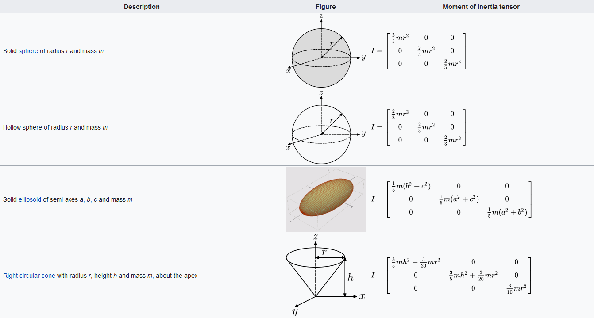
Moment of Inertia Tensors
Source: https://en.wikipedia.org/wiki/List_of_moments_of_inertia

Slide 11
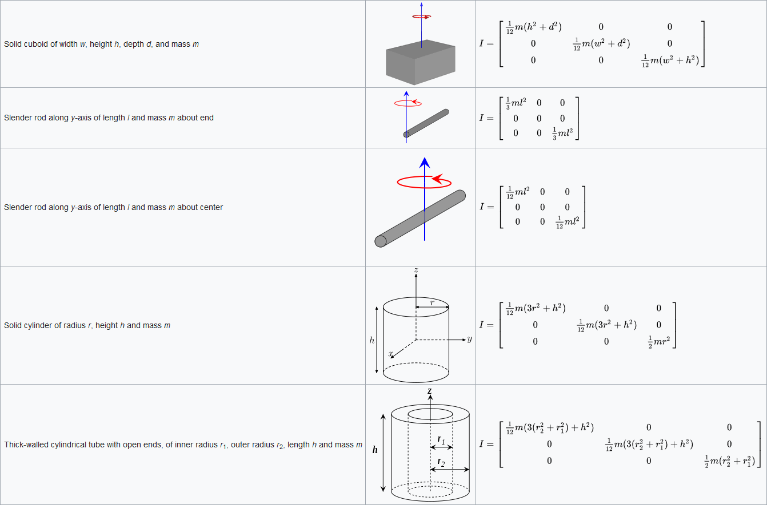
Moment of Inertia Tensors
Source: https://en.wikipedia.org/wiki/List_of_moments_of_inertia

Slide 12

Rotation
To update rotational velocity use:
$ω_{f}=ω_{i}+αt$
Where: $α$ is rotational acceleration
And: $t$ is the timestep
Find $α$ using torque:
$τ=Iα$
Therefore:
$ω_{f}=ω_{i}+I^{−1}τt$

Slide 13

BUT…
$ω_{f}=ω_{i}+I^{−1}τt$ requires the inertia tensor be in world space.
The inertia tensor we have made is in object space.

Slide 14

Object To World Tensor
$I_{w}=RI_{o}R^{T}$
Where: $I_{w}$ is the inertia in world space.
And: $I_{o}$ is the inertia in object space.

Slide 15

Rotating Around X
2D:
  $R\left(θ\right)=\left(\begin{matrix}cosθ & −sinθ \\ sinθ & cosθ\end{matrix}\right)$
3D:
  $R_{x}\left(θ\right)=\left(\begin{matrix}1 & 0 & 0 \\ 0 & cosθ & −sinθ \\ 0 & sinθ & cosθ\end{matrix}\right)$

Slide 16

Rotating Around Y
2D:
  $R\left(θ\right)=\left(\begin{matrix}cosθ & −sinθ \\ sinθ & cosθ\end{matrix}\right)$
3D:
  $R_{x}\left(θ\right)=\left(\begin{matrix}cosθ & 0 & sinθ \\ 0 & 1 & 0 \\ −sinθ & 0 & cosθ\end{matrix}\right)$

Slide 17

Rotating Around Z
2D:
  $R\left(θ\right)=\left(\begin{matrix}cosθ & −sinθ \\ sinθ & cosθ\end{matrix}\right)$
3D:
  $R_{x}\left(θ\right)=\left(\begin{matrix}cosθ & −sinθ & 0 \\ sinθ & cosθ & 0 \\ 0 & 0 & 1\end{matrix}\right)$

